Slide 1



Parallel Algorithms for Sorting and Searching
CS323 - Parallel and Distributed Computing

Slide 2

Intended Learning Outcomes
to explain the principles behind parallel sorting and searching algorithms, understanding how they improve efficiency in handling large datasets.
to design and implement a parallel sorting algorithm, such as parallel quicksort, using Python, demonstrating their ability to apply parallel techniques to common data operations.
to evaluate the performance of their parallel sorting and searching algorithms, identifying potential bottlenecks and applying basic optimization techniques to improve efficiency.

Slide 3
Parallel Algorithms
Sorting and Searching are fundamental operations that often become performance bottlenecks, especially when dealing with large datasets
Parallel algorithms – distribute tasks across multiple processors, can significantly enhance the efficiency of these operations

Slide 4
Parallel Algorithms for Sorting
Common Sorting algorithms suitable for large datasets
Quick Sort – average time complexity of O(n log n)
Merge Sort - guarantees time complexity of O(n log n) in most cases
Parallel sorting – utilizes multiple processors to perform sorting tasks simultaneously, improving the performance of sorting large datasets
Divide and Conquer paradigm in parallel sorting involves splitting the dataset into smaller segments, recursively sorting each segment, and finally merging the sorted segments --- this method optimizes resource utilization and minimizes computational overhead in distributed systems.

Slide 5
Parallel QuickSort
Parallel QuickSort Algorithm
Divide (Partitioning the array) - Input array is divided into three parts:
Left partition (elements < pivot)
Pivot (middle elements(s))
Right partition (elements > pivot)
Conquer (sorting in parallel)
Instead of sorting the left and right partitions sequentially, parallel quicksort assigns them to different processors/threads. Each partition is then sorted recursively using the same divide-and-conquer logic
Combine (merge results)
Since quicksort sorts in place, merging is just concatenating the sorted left partition, pivot, and sorted right partition.

Slide 6
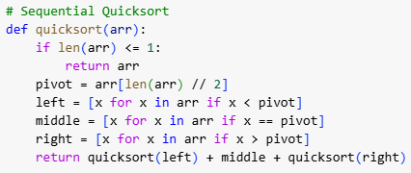
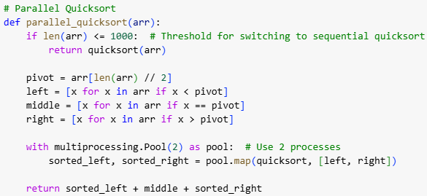
Parallel QuickSort
single-threaded
parallel quicksort assigns them to different processors/threads

Slide 7
Parallel Algorithms for Searching
Parallel search algorithms distribute the search process across multiple processing units (threads, cores, or machines) to speed up searching in large datasets. Instead of searching sequentially through the entire dataset, the workload is split.
Example
Parallel Binary Search
A binary search (time complexity of O(n log n) normally performed sequentially but in parallel binary search, multiple threads or processes are used to work on different segments of the datasets simultaneously
Reduces time complexity from O(log N) per search to a more efficient parallelized search across multiple processors.

Slide 8
Parallel Binary Search
Parallel Binary Search Algorithm
Divide the Sorted Array
Assign different sections of the array to different processors
Each processor runs binary search independently on its assigned subarray
Perform binary search in parallel
Each processor searches for the target value in its assigned range
If a processor finds the target, it terminates other search processes
Merge and determine the result
If a processor finds the target, the result is returned immediately
If no processor finds the value, return not found.

Slide 9
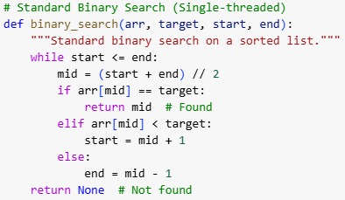
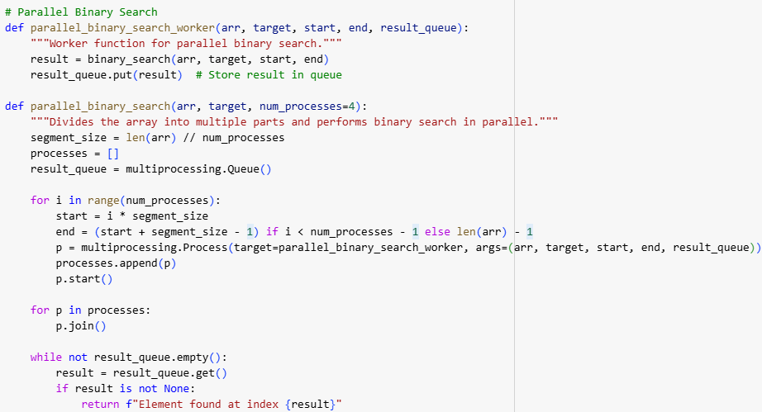
Parallel Binary Search
single-threaded
multiple threads or processes are used to work on different segments of the datasets simultaneously

